Slide 1
Capstone Engagement
Assessment, Analysis, and Hardening of a Vulnerable System

Slide 2
Table of Contents
This document contains the following sections:
01
Network Topology
02
Red Team: Security Assessment
03
Blue Team: Log Analysis and Attack Characterization
Hardening: Proposed Alarms and Mitigation Strategies
04

Slide 3
Network Topology
3

Slide 4
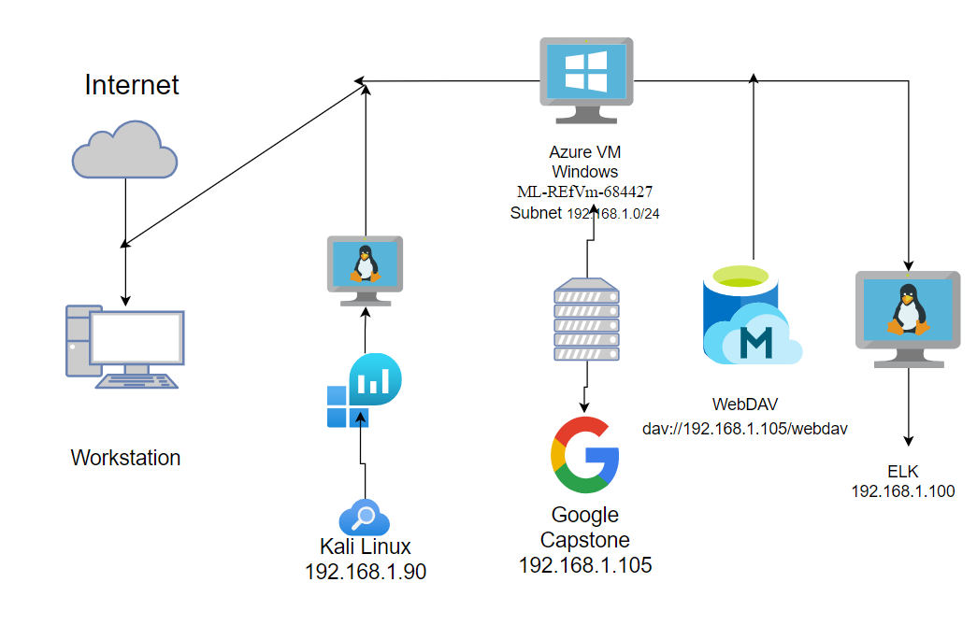
Network Topology
[Insert Here]
Use draw.io to create a diagram of the network.
Add your diagram to this slide and fill out the data in the sidebar.
Network
Address Range:
192.168.1.0/24
Netmask:255.255.255.0
Gateway:192.168.1.1
Machines
IPv4:192.168.1.90
OS:Linux
Hostname: Kali
IPv4:192.168.1.105
OS:Linux
Hostname: Capstone
IPv4: 192.168.1.100
OS:Linux
Hostname: ELK
IPv4:192.168.1.1
OS: WIndows
Hostname:ML-REfVm-684427

Slide 5

Red Team
Security Assessment
5

Slide 6
Recon: Describing the Target
Nmap identified the following hosts on the network:
Hostname | IP Address | Role on Network
ML-REfVm-684427 | 192.168.1.1 | Host Machine
Kali | 192.168.1.90 | Attacker Machine (used for penetration testing)
Server 1 (Capstone) | 192.168.1.105 | Virtual Machine
ELK | 192.168.1.100 | Monitoring Machine

Slide 7
Vulnerability Assessment
The assessment uncovered the following critical vulnerabilities in the target:
Vulnerability | Description | Impact
Secret_folder is public | The files once clicked on display that the knowledge is help within ‘secret_folder’. | It was informational to lead us to the directory file path
Brute Force | Allowed unlimited attempts of usernames and passwords (log in’s) | It allows us to use tools such as “hydra” in order to gain access to log in.
Webdav | Any person from any IP address with Ryan's credentials had the propensity to upload whatever they want or take whatever information they want. | Any files from any IP address could upload or download files. This led to us uploading shell. php
Based Buffer-overlow .php | This vulnerability allows attacker to deliver arbitrary code | This allows user to view, change, delete r escalate permissions for users.

Slide 8
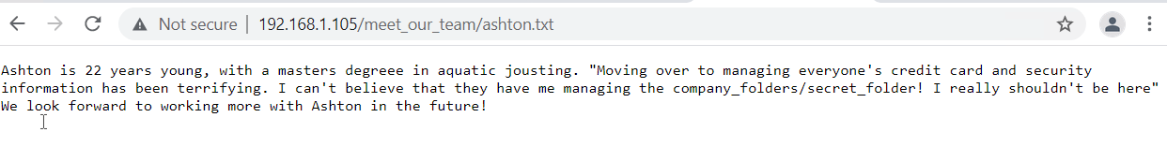
Exploitation: [Data Exposure]
01
02
03
Tools & Processes
First, we utilized nmap to scan the netowrk. Then we navigated to 192.168.1.105. A reoccuring message kept poping up with the file path to the secret folder (192.168.1.105/company_folders/secret_folder/).
Achievements
This granted access to files that directed us to the secret folder. From here we were able to find names of employees in order to attempt to log in as one or more of them.

Slide 9
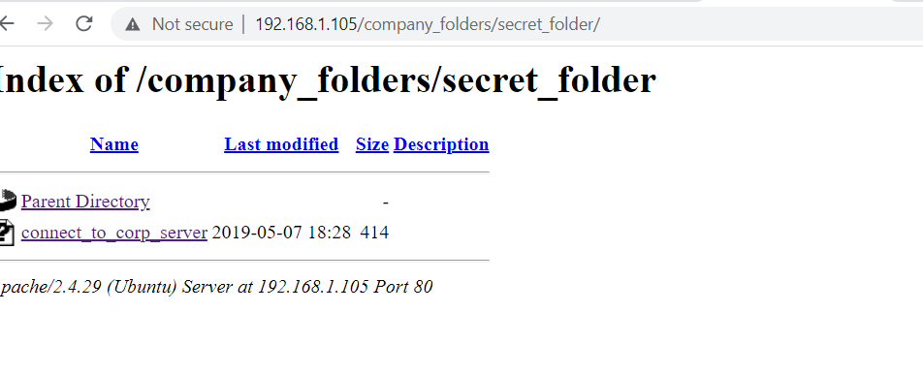
Exploitation: [Brute Force Attack]
01
02
03
Tools & Processes
The brute force attack was done with the use of hydra against the direcotry to crack Ashton’s log in.
Achievements
This enabled us to log into the network with Ashton’s credentials and connect to the Webdav.
hydra –l ashton –P rockyou.txt –s 80 –f –vV 192.168.1.105 http-get /company_folders/secret_folder/

Slide 10
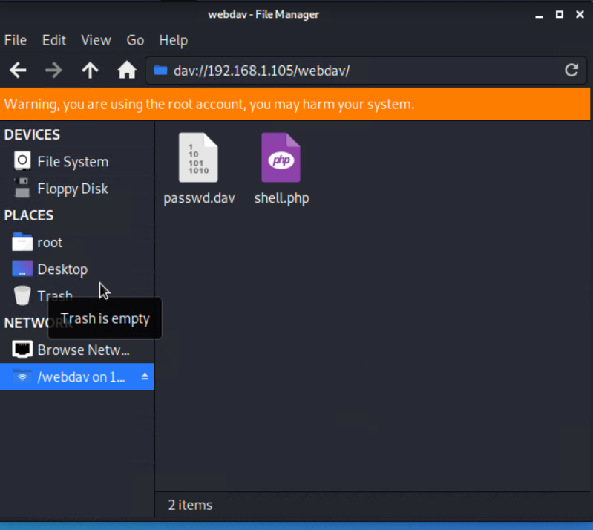
Exploitation: [Remote Code Execution]
01
02
03
Tools & Processes
https://crackstation.net was used to crack the hash for Ryan’s password to log into the Webdav.
Achievements
Logging into the webdav enables access to retrive and upload data at will. This granted root access to upload the reverse shell.

Slide 11

Blue Team
Log Analysis and Attack Characterization
11

Slide 12

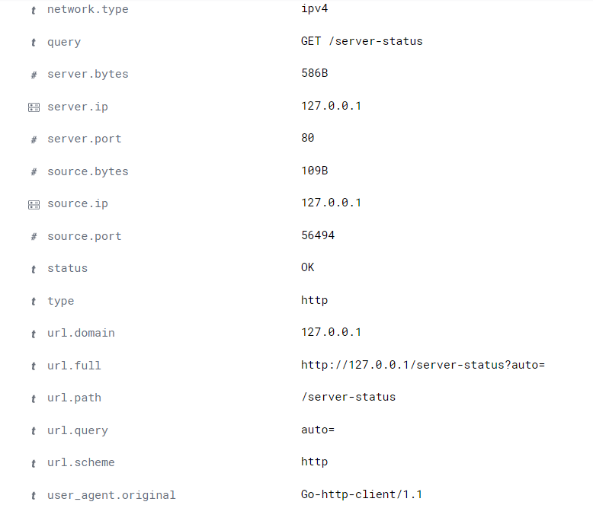
Analysis: Identifying the Port Scan
July 26 2021 at 23:30
723 Packets from 127.0.0.1
Ping requests were sent in a matter of seconds to 192.168.0.105
What time did the port scan occur?
How many packets were sent, and from which IP?
What indicates that this was a port scan?
[Insert Here]
Include a screenshot of Kibana logs depicting the port scan.

Slide 13
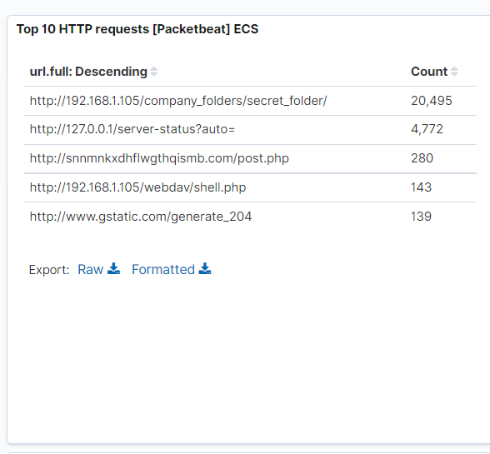
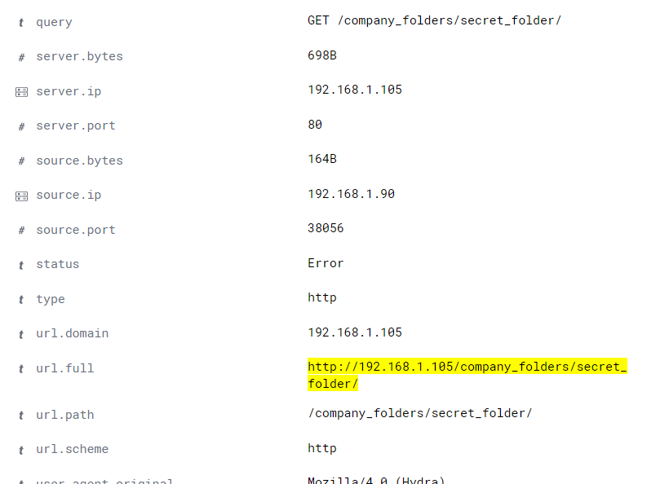
Analysis: Finding the Request for the Hidden Directory
This occurred July 26 2021 during the hour of 22:00-23:00. The request amount is 20,492
http://192.168.1.105/company_folders/secret_folder
These file contained instructions on how to access the company WebDAV
What time did the request occur? How many requests were made?
Which files were requested? What did they contain?
[Insert Here]
Include a screenshot of Kibana logs depicting the request for the hidden directory.

Slide 14
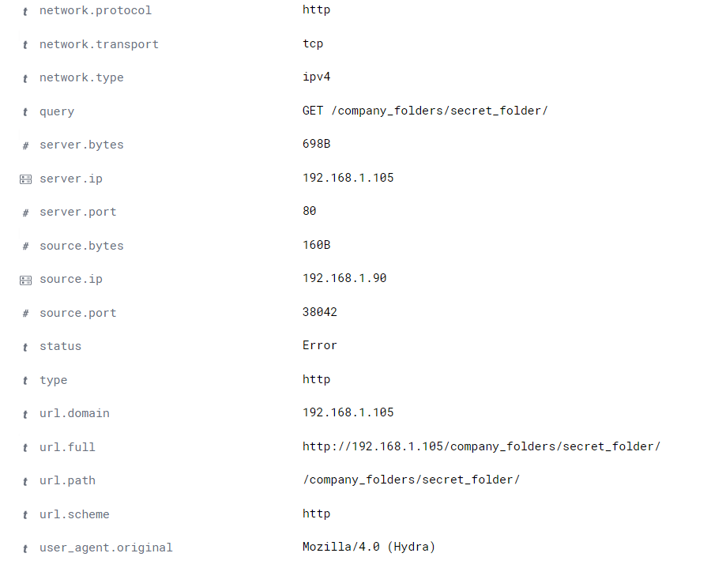
Analysis: Uncovering the Brute Force Attack
720.
600
How many requests were made in the attack?
How many requests had been made before the attacker discovered the password?
[Insert Here]
Include a screenshot of Kibana logs depicting the brute force attack.

Slide 15
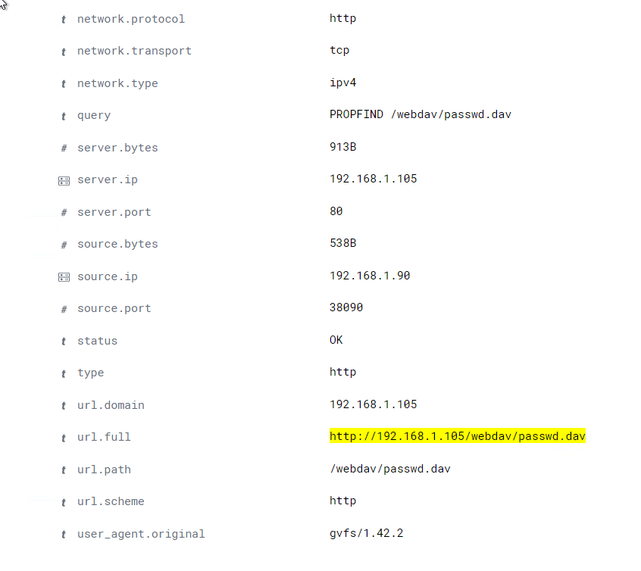
Analysis: Finding the WebDAV Connection
96 Request made
“passwd.dav” file was requested via GET, and “shell.php” uploaded via POST
How many requests were made to this directory?
Which files were requested?
[Insert Here]
Add a screenshot of Kibana logs depicting the WebDAV connection.

Slide 16
Blue Team
Proposed Alarms and Mitigation Strategies
16

Slide 17
Mitigation: Blocking the Port Scan
What kind of alarm can be set to detect future port scans?
An alarm could be set to trigger if the error transactions outwey the successful transactions. Or as most large corpaerations do now the ICMP can be shut off to the public.
What threshold would you set to activate this alarm?
I would set the threashold to greater or equal to 12.
What configurations can be set on the host to mitigate port scans?
There are several options, but I would suggest to either configure or install a firewall or utilize a TCP wrapper.
Describe the solution. If possible, provide required command lines.
-Firewall: can be either installed or configured from scratch in order to properly route traffic throughout the network.
-TCP wrapper: grants administrators the ability to deny or permit server access based upon IP addresses or domain names.

Slide 18
Mitigation: Finding the Request for the Hidden Directory
What kind of alarm can be set to detect future unauthorized access?
The alarm should be set to occur when non whitelisted IP’s log onto the “secret_folder” server.
What threshold would you set to activate this alarm?
I would set this threshold to greater or equal to one wince this is a high priority asset.
What configuration can be set on the host to block unwanted access?
The hidden folder should be moved to a secure server with only key-based SSH access from whitelisted IP’s.
Describe the solution. If possible, provide required command lines.
An asymmetric key pair is generated to secure data so only personnel with the correct key pair can access the hidden directory.

Slide 19
Mitigation: Preventing Brute Force Attacks
What kind of alarm can be set to detect future brute force attacks?
A real-time alarm should be set to alert when the amount of unsuccessful attempts has exceeded the threshold set.
What threshold would you set to activate this alarm?
10-15 Unsuccessful attamps should set off an alarm depending on the usual amount of unsuccessful attemps.
What configuration can be set on the host to block brute force attacks?
-Limitation to log in attempts.
-Two factor authentication.
Describe the solution. If possible, provide the required command line(s).
-Limit logins: a threshold can be set for log-in attempts with some sort of repercussion such as account lock out for a set amount of time or even deletion of information.
-Two-factor Authentication: requires a password as well as another method of authentication to enable the user to log in. Examples of this include: a pin, temporary code or fingerprint.

Slide 20
Mitigation: Detecting the WebDAV Connection
What kind of alarm can be set to detect future access to this directory?
A real-time alarm could be set in order to alert when an unauthorized IP is connected to the organizations WebDAV.
What threshold would you set to activate this alarm?
I would set the threshold to greater than or equal to one login because this leaves the network vulnerable to any attack when this occurs.
What configuration can be set on the host to control access?
Access to the WebDAV can have restriction based on: individual UID, group of individual and restriction of read or write access.
Describe the solution. If possible, provide the required command line(s).
Administrator can set restriction access based upon individual UID, group of individual and restriction of read or write access.

Slide 21
Mitigation: Identifying Reverse Shell Uploads
What kind of alarm can be set to detect future file uploads?
Applying an application aware firewall can be set to alert when uploads are attempted.
What threshold would you set to activate this alarm?
I would set the threshold of greater than or equal to one because once the shell uploads the network is suspectable to a breach or even a DoS.
What configuration can be set on the host to block file uploads?
The server should implement an upload filter and additionally restrict users from uploading any executable code within in file uploads.
Describe the solution. If possible, provide the required command line.
An upload filter is a automated tool used for content recognition and blocking. This can block content based on its algorithm.

